Slide 1
Introduction to NIKA
NIKA is revolutionizing how businesses and governments design, build and manage real property. By combining architecture, engineering, planning, technology, advisory, program management, logistics, operations and maintenance services all under one roof, we are able to provide a significant value-add to our clients.

Slide 2
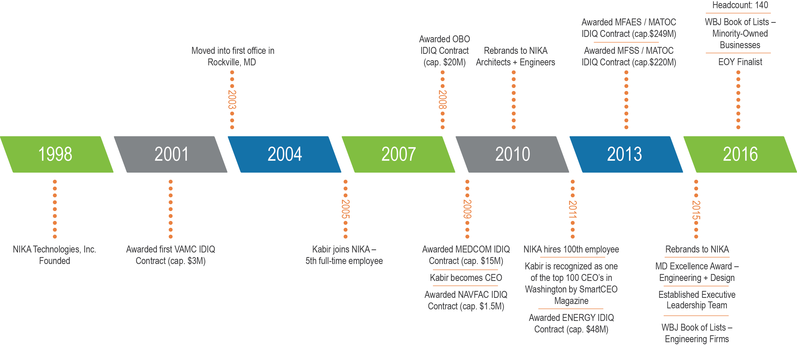
NIKA Highlights
Dual commercial and government growth strategy
Continuous focus on process improvement, quality, and client service
Full service A/E firm, including Architecture, Interiors, MEP, Fire Protection and Physical Security
Expertise beyond core A/E to include innovative and proven solutions that augment building information management systems
Past performance with virtually all levels of government and extensive experience with highly specialized and complex engagements
Advanced technologies (e.g., Revit/BIM) and proven QA/QC processes are leveraged in order to provide greater reliability, efficiency and value for our clients
Culture, talent and bench strength to quickly scale up or down to any sized engagement

Slide 3
Top Management A Track Record of Success
NIKA’s leadership team has a proven reputation for unparalleled experience and knowledge. With diverse capabilities and a deep talent pool, we go beyond A/E to provide full-service solutions and valuable business advice.
Kabir Chaudhary
Chief Executive Officer
Usman Shakir
Chief Financial Officer, EVP
Stephen White
Chief Marketing Officer, EVP
Chip Denman
Executive Vice President
Mark Smith
Senior Vice President
Kabir oversees all business development and strategic operation aspects of the firm
Usman leads Finance, Human Resources and Network Administration
Stephen leads Marketing and Business Development
Chip leads the firm’s business development efforts, including government relations and legislative affairs
Mark leads Architecture and Program Management
Award winning leadership team committed to innovation, quality and exceptional client service
Nearly 100 years of combined management and professional services know-how
Extensive government contracting and industry experience in both privately held and publicly traded companies
Broad knowledge of government and military operations
Forward-thinking leadership team with a passion for business
Developed marketing and sales engine capable of delivering high growth
Achieved 92.3% compounded annual growth from 2013 to 2015
Increased employee headcount 200% in six years

Slide 4
NIKA Service Lines and Core Services
With diverse in-house expertise, NIKA provides a multitude of services to drive your project to success.
NIKA’s Specialties
NIKA is a full-service design, architecture and engineering, facilities support, program management, and enterprise technology firm. We specialize in the planning, designing, building, engineering, management, facilities support, and maintenance of complex facilities and infrastructures.
Governments and commercial industries turn to NIKA for specialized expertise in:
Medical & Healthcare Facilities
Laboratories
Research & Design Studios
Complex & Secure Facilities
Sensitive Compartmentalized Information Facilities (SCIF)
NIKA has developed a platform of integrated services that help clients achieve success. These service lines – Architecture and Engineering, Logistics, Operations and Maintenance, Advisory, Program Management, and Enterprise Technologies – work together to drive success for our clients.
Architecture and Engineering
Architecture
Interior Design
Concept/Schematic Design
Phased Renovation Design
Construction Design and Administration
Mechanical, Electrical & Plumbing Design
Fire Protection
Physical Security
Logistics, Operations, and Maintenance
Facilities, Operations & Maintenance
Logistics Coordination
Facilities Data Analytics & Management
CAFM/CMMS Support
Advisory
Energy Audits & Benchmarking
Feasibility Studies & Critical Path Method
Modeling/Design Conflict Analysis
Program Management
Quality Assurance and Quality Control
Performance Measurement Reporting
Construction & Technical Management
Enterprise Technologies
Asset & Inventory Management
Application Design and Development
Database Design, Management and Integration
Business Intelligence
With our diverse portfolio of service offerings, large pool of talented professionals, and an established record of success, NIKA is the total solution for governments and commercial businesses.
Notes:
NIKA’s Core Services Include:
Advisory
Energy Audits & Benchmarking
LEED Design and Certification
Feasibility Studies
Infrastructure and Master Planning
Critical Path Method (CPM)
Preparation and Review
Modeling/Design Conflict Analysis
Architecture, Engineering and Planning
Concept/Schematic Design
Phased Renovation Design
Construction Design
Construction Administration
Requirements Planning
Cost Estimating
Mechanical, Electrical & Plumbing Design
Fire Protection
Interior Design
Furniture, Fixtures & Equipment
Enterprise Technologies
Asset & Inventory Management
Application Design and Development
Database Design, Management and Integration
Logistics, Operations, and Maintenance
Facilities, Operations & Maintenance
Logistics Coordination
Facilities Data Analytics & Management
Program Management
Quality Assurance and Quality Control
Performance Measurement Reporting
Construction & Technical Management

Slide 5
NIKA Advisory
Expertise You Can Count On
Whether you want to improve an existing building or design and build a modern, energy-conscious facility, you can count on NIKA’s expert knowledge of regulatory requirements and keen understanding of technology trends.
NIKA’s Advisory Group offers a full spectrum of consulting services to clients across the globe, including:
Building Energy Benchmarking and Audits
Energy Master Planning Studies including Renewable Technologies
Energy Driven Continuous Commissioning
High Performance Building Energy Modeling and Design Assistance
Energy Code Compliance Verification and Enforcement
Ongoing Building Energy Performance Monitoring and Analysis (Subscription/Retainer based)
Energy Systems Optimization and Operation and Maintenance Training
Whether we are conducting energy and water audits to improve building or campus-wide efficiencies and reduce operating costs, strategically planning and aligning building/renovation/remodeling projects where space is limited, or automating and streamlining your facility management using our patent-pending RPIE tag technology, NIKA can help provide you the most optimum solution.
Advisory
Architecture & Engineering
Enterprise Technologies
Logistics, Operations, Maintenance
Program Management
Notes:
NIKA’s Core Services Include:
Advisory
Energy Audits & Benchmarking
LEED Design and Certification
Feasibility Studies
Infrastructure and Master Planning
Critical Path Method (CPM)
Preparation and Review
Modeling/Design Conflict Analysis
Architecture, Engineering and Planning
Concept/Schematic Design
Phased Renovation Design
Construction Design
Construction Administration
Requirements Planning
Cost Estimating
Mechanical, Electrical & Plumbing Design
Fire Protection
Interior Design
Furniture, Fixtures & Equipment
Enterprise Technologies
Asset & Inventory Management
Application Design and Development
Database Design, Management and Integration
Logistics, Operations, and Maintenance
Facilities, Operations & Maintenance
Logistics Coordination
Facilities Data Analytics & Management
Program Management
Quality Assurance and Quality Control
Performance Measurement Reporting
Construction & Technical Management

Slide 6
NIKA Architecture & Engineering
Design that Motivates and Inspires
With a full complement of in-house A/E professionals, NIKA stands out from the competition. Our employees are licensed architects and engineers, CAD designers, operators, technicians, programmers, interior designers, project managers, security specialists and spec writers with focused expertise in:
Architecture
Master Planning
Interior Design
Mechanical, Electrical & Plumbing Design
Fire Protection
Physical Security
Low Voltage Design
In addition, NIKA provides a number of specialized services:
Full Design and Documentation Services from Concept Design Through Construction Documents
Facility Condition Assessments (FCA), including Feasibility Studies
Whole Building Commissioning
Building Information Modeling (BIM)
From concept through construction, NIKA is committed to forming lasting partnerships by providing innovative solutions to meet your real-world needs. Our collaborative approach and dedication to sound decision-making results in a forward-thinking solution for every client.
Architecture & Engineering
Enterprise Technologies
Logistics, Operations, Maintenance
Program Management
Advisory
Notes:
NIKA’s Core Services Include:
Advisory
Energy Audits & Benchmarking
LEED Design and Certification
Feasibility Studies
Infrastructure and Master Planning
Critical Path Method (CPM)
Preparation and Review
Modeling/Design Conflict Analysis
Architecture, Engineering and Planning
Concept/Schematic Design
Phased Renovation Design
Construction Design
Construction Administration
Requirements Planning
Cost Estimating
Mechanical, Electrical & Plumbing Design
Fire Protection
Interior Design
Furniture, Fixtures & Equipment
Enterprise Technologies
Asset & Inventory Management
Application Design and Development
Database Design, Management and Integration
Logistics, Operations, and Maintenance
Facilities, Operations & Maintenance
Logistics Coordination
Facilities Data Analytics & Management
Program Management
Quality Assurance and Quality Control
Performance Measurement Reporting
Construction & Technical Management

Slide 7
NIKA Enterprise Technologies
Where Innovation Meets Performance
Born out of the need to help the U.S. government manage infrastructure, equipment and resources at over 200 facilities simultaneously, NIKA’s creative tools and processes address the specific architecture,
engineering, operations and maintenance requirements inherent to facilities, equipment and infrastructure.
Whether you want to improve data collection tactics, facilitate or enforce business processes, develop
effective analytics, or commission a new website or application, NIKA can help. We understand the
intricacies, design challenges, and security issues surrounding today’s facility technology, which is why we are particularly adept at solving real issues with real solutions, including:
Asset Tagging and Inventory Management
Database Design, Management and Integration
Facility Analytics, Business Intelligence and Custom Reporting
Agile Software Development
Mobile Application Design and Development
Website Development and Section 508 Accessibility Compliance
Building Control System Cybersecurity Risk Management
Our experts have unique and proven experience with the top facility-related technologies, including Real Property Inventory Equipment (RPIE) tagging, DMLSS-FM, BUILDER, PAVER, the World Class Facilities Toolkit and more.
For years, we have been ahead of the curve, helping governments and industry recognize efficiencies, reduce operating costs, and improve performance. Whether you need an off-the-shelf solution or one that is entirely customized for your unique facilities, NIKA can show you exciting new possibilities.
Enterprise Technologies
Logistics, Operations, Maintenance
Program Management
Advisory
Architecture & Engineering
Notes:
NIKA’s Core Services Include:
Advisory
Energy Audits & Benchmarking
LEED Design and Certification
Feasibility Studies
Infrastructure and Master Planning
Critical Path Method (CPM)
Preparation and Review
Modeling/Design Conflict Analysis
Architecture, Engineering and Planning
Concept/Schematic Design
Phased Renovation Design
Construction Design
Construction Administration
Requirements Planning
Cost Estimating
Mechanical, Electrical & Plumbing Design
Fire Protection
Interior Design
Furniture, Fixtures & Equipment
Enterprise Technologies
Asset & Inventory Management
Application Design and Development
Database Design, Management and Integration
Logistics, Operations, and Maintenance
Facilities, Operations & Maintenance
Logistics Coordination
Facilities Data Analytics & Management
Program Management
Quality Assurance and Quality Control
Performance Measurement Reporting
Construction & Technical Management

Slide 8
NIKA Logistics, Operations, and Maintenance
Professional Problem Solvers
What logistic challenges are keeping you awake at night? Chances are that they are the same ones that our professional problem solvers have helped dozens of clients address.
Every day, in dozens of countries, NIKA’s experienced workforce and proven systems are helping clients mitigate risk, recognize efficiencies, improve performance, and exceed expectations. Our advanced design systems simplify and streamline the logistics, operations and maintenance of large-scale, complex facilities. NIKA successfully delivers uncompromising quality logistic solutions that include:
Facilities Management and Maintenance
Construction Management
Asset Tagging and Management
Procurement Assistance
Life Cycle Management
Warehousing Operations
Inventory Control
Transportation Systems Analysis
Life Safety and Fire Protection Management
Medical Facility Real Property Planning and Analysis System (RPLANS)
Project Management
Energy and Water Monitoring
Our facility experts also have extensive experience with BUILDER software, the DMLSS-FM system, facility condition assessments, Real Property Installed Equipment (RPIE) tagging, and reliability-centered
maintenance (RCM).
Logistics, Operations, Maintenance
Program Management
Advisory
Architecture & Engineering
Enterprise Technologies
Notes:
NIKA’s Core Services Include:
Advisory
Energy Audits & Benchmarking
LEED Design and Certification
Feasibility Studies
Infrastructure and Master Planning
Critical Path Method (CPM)
Preparation and Review
Modeling/Design Conflict Analysis
Architecture, Engineering and Planning
Concept/Schematic Design
Phased Renovation Design
Construction Design
Construction Administration
Requirements Planning
Cost Estimating
Mechanical, Electrical & Plumbing Design
Fire Protection
Interior Design
Furniture, Fixtures & Equipment
Enterprise Technologies
Asset & Inventory Management
Application Design and Development
Database Design, Management and Integration
Logistics, Operations, and Maintenance
Facilities, Operations & Maintenance
Logistics Coordination
Facilities Data Analytics & Management
Program Management
Quality Assurance and Quality Control
Performance Measurement Reporting
Construction & Technical Management

Slide 9
NIKA Program Management
Minimizing Risk and Maximizing Quality
At every stage of the project life cycle, NIKA works to optimize the structure, planning, analysis, and performance of your programs and projects. NIKA can help you consistently deliver increasingly complex programs and projects faster, while keeping costs down and quality high.
The NIKA name is synonymous with quality and leadership. We support your needs throughout the project lifecycle with project managers, quality assurance managers, and technical managers who provide a variety of support services, including:
Project Development Support
Coordination of Contractors
Verification of Contractor-Installed Items
Coordination with Safety Officers
Code & Criteria Compliance
Quality Reviews
Schedule Evaluation
Safety Oversight
Coordination with Stakeholders
Space Management
At NIKA, every program is delivered in alignment with a client’s mission while meeting very strict goals along the way – doing it on time and on budget. NIKA’s program management team has the experience necessary to help you accurately identify requirements, define measurable performance standards, and manage life cycle activities.
Program Management
Advisory
Architecture & Engineering
Enterprise Technologies
Logistics, Operations, Maintenance
Notes:
NIKA’s Core Services Include:
Advisory
Energy Audits & Benchmarking
LEED Design and Certification
Feasibility Studies
Infrastructure and Master Planning
Critical Path Method (CPM)
Preparation and Review
Modeling/Design Conflict Analysis
Architecture, Engineering and Planning
Concept/Schematic Design
Phased Renovation Design
Construction Design
Construction Administration
Requirements Planning
Cost Estimating
Mechanical, Electrical & Plumbing Design
Fire Protection
Interior Design
Furniture, Fixtures & Equipment
Enterprise Technologies
Asset & Inventory Management
Application Design and Development
Database Design, Management and Integration
Logistics, Operations, and Maintenance
Facilities, Operations & Maintenance
Logistics Coordination
Facilities Data Analytics & Management
Program Management
Quality Assurance and Quality Control
Performance Measurement Reporting
Construction & Technical Management

Slide 10
The NIKA Advantage Why NIKA is the Right Choice
Understanding the bigger picture. With integrated services and a large pool of industry experts, there are seven great reasons why government and industry choose NIKA.
Deep Expertise, Extensive Capabilities
What sets NIKA apart from other architecture and engineering firms is our extensive reach and diverse capabilities. We offer a wide range of ancillary services that complement each other in order to form a more complete solution that addresses more of your needs.
Excellence in Project Management
With a dedicated project management office (PMO) onsite, NIKA supports you through the entire project lifecycle with a wide variety of support services, including project development support, coordination of contractors and their projects onsite, verification of contractor-installed items, coordination with contracting officers, QA/QC and enterprise technology. We provide project managers, quality assurance managers, and technical managers to facilities throughout the United States.
Multiple Disciplines Under One Roof
Unlike most A/E firms, NIKA maintains wide range of experts working on staff at the same location. This guarantees strong collaboration among our multi-disciplinary teams, resulting a more comprehensive work product, as well as time/cost savings for our clients.
Budget and Schedule Driven
In a fiscally-constrained environment, it's important to stay on schedule and on budget. We establish budgets early in the design phase, build a team we trust, and focus on project options that have the most significant cost impacts. Most importantly, we deliver projects on time and to expectations.
.
Commitment to Quality Assurance and Control
Quality assurance and control is more than just a promise at NIKA. We build QC into every aspect of a project, documenting all meetings and putting controls in place for every deliverable we complete. Multiple levels of review ensure that work is completed in a manner that exceeds client expectations.
Certified Thought Leaders
At NIKA, we take knowledge seriously. We hire the best and brightest experts in every area of the firm. Whether you need a LEED-accredited architect, a licensed engineer, a certified project manager, or a skilled fire protection expert, we have the professional expertise to get the job done.
Advanced Technologies
NIKA is revolutionizing the way we approach the design and building process, leveraging state-of-the-art technology (e.g., Revit/BIM) and proven quality assurance and control process to provide greater reliability, efficiency, and value for our clients.
Notes:
All regulatory requirements:
OSHA - Occupational Safety and Health Agency
EPA - Environmental Protection Agency
JCAHO - Joint Commission of Accreditation of Healthcare Organizations
AHERA - Asbestos Hazard Emergency Response Act
NESHAPS - National Emissions Standards for Hazardous Air Pollutants Asbestos Standards
NFPA - Applicable codes published by the National Fire Protection Association
UBC – Unified Building Code
IBC – International Building Code
ADA – American Disabilities Act
NEC – National Electric Code
EQB – Environmental Quality Board
ANSI – American National Standards Institute
IEEE – Institute of Electrical and Electronic Engineers
ACI - American Concrete Institute
ASIC – American Society of Irrigation Consultants
ASHRAE - American Society of Heating, Refrigeration & Air-Conditioning Engineers
UFAS – Uniform Federal Accessibility Standards
ADAAG - ADA Accessibility Guidelines
NEPA National Environmental Protection Agency

Slide 11
Tiered Services Ensuring Project Success
From concept through to construction, we engage in all facets of the design and build process.
Tier I – Design Concept Services (DC)
NIKA works with clients to develop a broad-brush design concept and understanding. We define a general design program that will identify and meet defined requirements.
Concept Design
Schematic Design
Design Development
Design/Build RFP Packages
Tier II - Construction Design Services (CD)
We enable our clients to make informed decisions concerning the project’s program, building size, massing and form, sustainable design options, as well as budget requirements. NIKA prepares an accurate set of Pricing Drawings suitable for building permitting and general pricing of the project. The pricing drawings and outline specifications for the project are then competitively priced. Clients are then able to test the design against the budget before completing all construction drawings and specifications. NIKA develops a project budget estimate form that is filled out by all competing contractors and we assist with estimate evaluation and contractor selection.
Planning and Budgeting
Development of Construction Documents
Bidding and Source Selection
Tier III - Construction Administration Services (CA)
NIKA acts as a full-service liaison between owners, designers, and contractors, we make sure that construction documents support the design intent, while minimizing risk and preventing the common issues that can arise during a build.
RFI Response and Tracking
Submittal Processing
Shop Drawing Review
Cost Control
Communication Management
Punch List Management

Slide 12
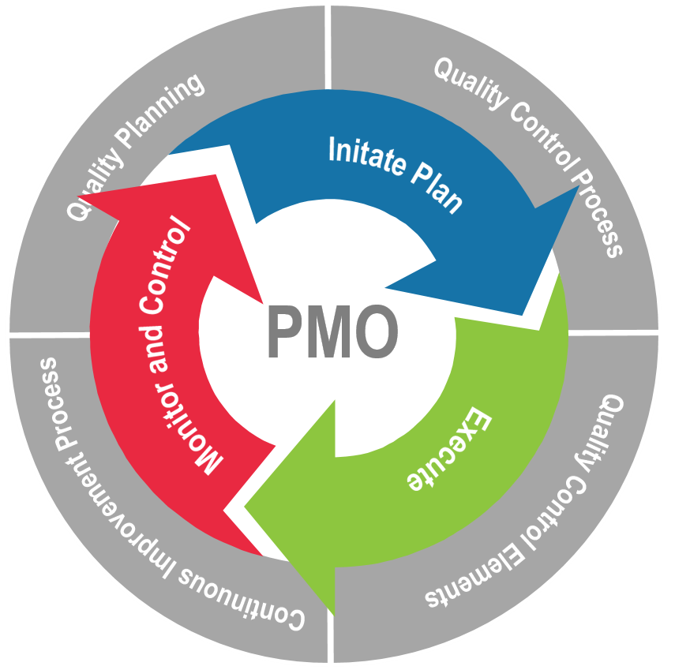
Quality Control Best Practices to Ensure Quality
NIKA’s Quality Control Approach
NIKA has established a structured quality management program that defines our quality policy, quality objectives, standard quality activities, and corporate quality management structure. We will tailor and directly leverage this framework for our clients in order to:
Develop QCPs and PMPs to support project objectives
Provide periodic and consistent reviews of the services we provide to ensure integrity, correctness, and completeness
Identify and address errors and omissions
Describe a communications approach with leadership to handle corrective actions and potential improvements to the program services
Document and archive deliverables and record all QC processes
Collect, report, and respond to performance measures
Strive to continuously improve overall project quality and performance over time

Slide 13
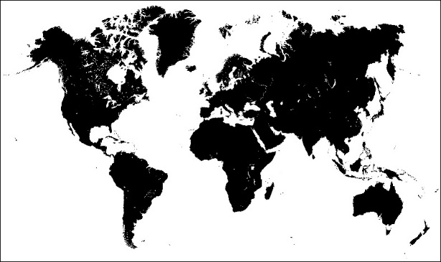
NIKA At-a-Glance Where Depth Meets Reach
Enjoy the best of both worlds: A locally-owned and operated business with extensive reach and capability. Leverage NIKA’s proven strengths to your advantage.
Geographic Reach
Total Construction Dollar Value (LTD)
45 States
23 Countries
Working coast-to-coast
and around the globe.
International ($500M)
Contract Success
Total Government Contracts (8yr)
2015/16 Government Contracts
Domestic ($4B+)
761 Transactions
$111.5M Funds Awarded
16 Agencies
125 Transactions
$33M Funds Awarded
3 1st Time Agencies
Studio Demographics
EIT/IDPs
Bench Strength
150 employees
Nearly 100 live and work in the region; the rest are stationed around the globe
More than 75 A/E specialists on staff
Licensed A/E
Accredited PMPs

Slide 14
Clients, Partners and Community Working Together
Building strong partnerships and key relationships. Benefit from NIKA’s strong ties with government agencies, corporate partnerships, education institutions, and the local business community.
Government
Partners
Higher Education
Community Involvement

Slide 15
Awards and Affiliations Recognizing Excellence
Delivered and time-tested in the most demanding, complex environments. With its innovative spirit and DNA, NIKA continues to change the way the customers design, build, and manage real property.
Awards and Nominations
Affiliations and Major Certifications
NIKA is fully licensed in the District of Columbia, Maryland and Virginia.

Slide 16
Connect/Contract with NIKA Let’s Get Started!
NIKA offers expert solutions with outstanding service. Contact us to learn what NIKA can provide for you.
Connect
NIKA Headquarters
451 Hungerford Drive, 4th Floor
Rockville, MD 20850
301.770.3520
301.770.3521
www.nikasolutions.com
NIKA Solutions
@LeadingDesign
NIKA
Business Point of Contact
Usman Shakir
Chief Financial Officer, EVP
ushakir@nikasolutions.com
301.770.3520 ext. 167
301.770.3521
Sales Point of Contact
Stephen White
Chief Marketing Officer, EVP
swhite@nikasolutions.com
301.770.3520 ext. 132
301.770.3521
Contract
Contract Vehicles
NIKA’s services are available on a multitude of contract vehicles. NIKA is on the GSA Professional Services Schedule (PSS) – additional modifications and schedules pending.
GSA PSS: GS -23F-0010R
MFSS: W912DY-14-D-0046
MFAES: W912DY-13-D-0120
ECIP: W912DY-11-D-0023
DUNS: 022016658
CAGE Code: 1XPF4
Set Asides: SBA Certified Minority-Owned Small Business Maryland (MDOT) Certified MBE / DBE / SBE (#05-407)
NAICS: 236210, 236220, 541310, 541330, 541340, 541350, 541512, 541513, 541519, 541611, 541618, 541690, 541990, 561210, 561320
O
F
O
F
O
F

